Slide 1
Secure Socket Layer

Slide 2
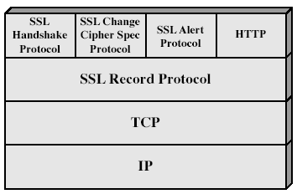
Secure Socket Layer
SSL use TCP to provide a reliable end-to-end secure service
SSL is not a single protocol but rather two layers of protocols

Slide 3
SSL record protocol provides basic security services to higher layer protocols
HHTP provides transfer service for web client/server interaction
The three higher layer protocols such as handshake , change cipher spec and alert protocols are used in the mgmt of SSL exchanges
2 impt concepts of SSL are SSL session and SSL connection
SSL Connection
Connection is a transport(as in OSI)that provides a suitable service . For SSL , such connections are peer to peer, connections are transient
Every connection is associated with one session

Slide 4
SSL Session
It is an association b/w a client and server
Sessions are created by handshake protocol
It define set of security parameters
Session state is defined by a
1.Session identifier
2.Peer certificate
3.Compression method
4.Cipher spec
5.Master secret-48 byte secret shared b/w client /server
6.Is resumable-A flag indicating whether the session can be used to initiate new connections

Slide 5
Connection state is defined by
1.Server and client random-Byte sequences
2.Server write MAC secret-Secret key used in MAC by server
3.Client write MAC secret-Secret key used in MAC by client
4.Server write key-encryption key of the server
5.Client write key-encryption key of the client
6.Initialization vectors(IV)-Maintained for each key
7.Sequencre numbers-For transmitting and receiving msgs

Slide 6
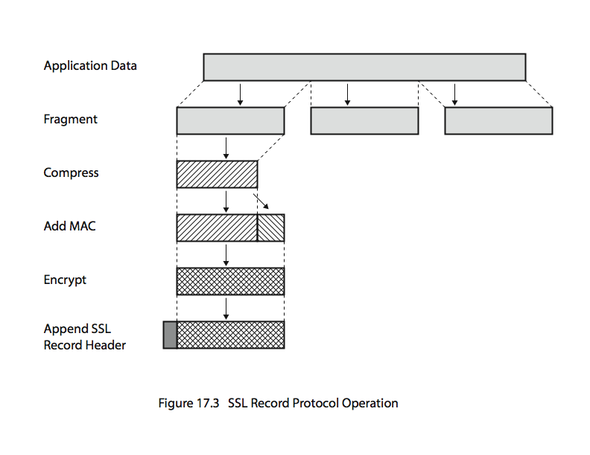
SSL Record Protocol
Provides 2 services
1.Confidentiality
2.Msg integrity

Slide 7
Working
The data to be transmitted is divided into diff fragments
Then compress each fragments , applies a MAC and encrypt
After encryption , adds a header and transmits the unit in a TCP segment
Received data are decrypted,verified decompressed and reassembled and then delivered to higher level users

Slide 8
Change Cipher Spec Protocol
It is one amng the three higher layer protocols that use SSL Record protocol and it is the simplest
It consist of a single msg which consists of a single byte with the value 1
Purpose of this msg is to cause the pending state to be copied into the current state which updates the cipher suite to be used on this connection

Slide 9
Alert Protocol
To convey SSL related alerts to the peer entity
This msgs are compressed and encrypted as specified by the current state
Each msg consist of 2 bytes
First byte takes the vale warning(1) or fatal(2) to convey the severity of the msg
If it is fatal,SSL terminates the connection
Second byte contains a code that indicates the specified alert

Slide 10
Handshake Protocol
It is the most complex part of SSL
It allows the server and client to authenticate each other
Uses encryption algm+MAC algm+keys to protect the data sent in an SSL record
The protocol is used b4 any data are transmitted
It consist of series of msgs exchanged by client and server
Each msg has 3 fields
Type(1 byte)-indicates one of 10 msgs
Length(3bytes)-length of msg
Content(>=1byte)-parameters associated with msg

Slide 11
Msg are exchanged through 4 phases
Phase 1:Establish security capabilities
Phase 2:Server Authentication and key exchange
Phase 3:Clent Authentication & Key Exchange
Phase 4:Finish
Rep of handshake protocol
Type | Length | Content

Slide 12
Other Upper Layer protocol(HTTP)
Here the content of the msg to be transmitted is included which is >=1byte
Opaque Content

